Slide 1
BI Internship Use Case Report
By: Iqrar Agalosi Nureyza

Slide 2
Table of Contents
1.1
1.2
Insights and Issues
Give report and suggestions
SQL Test
Solutions for SQL test

Slide 3
1.1
Section

Slide 4

Insights from the data

Slide 5
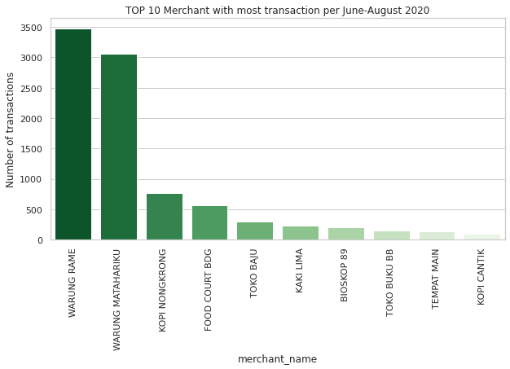
Warung Rame dominates the transactions data following by Warung Matahariku with 3000+ transactions

Slide 6
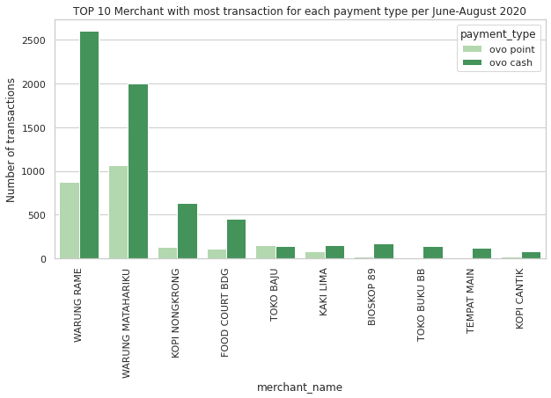
For each merchant on the TOP 10, payment using OVO Cash is dominating except Toko Baju. OVO Point payment on Toko Baju is slightly higher than OVO Cash.

Slide 7
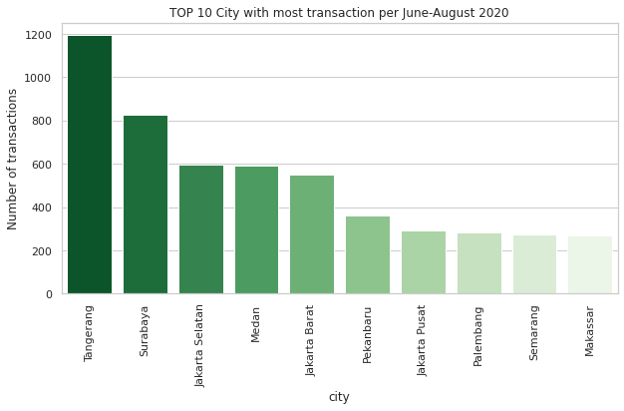
Tangerang is the city where customers and merchants have 1100+ total transactions. Following by Surabaya with 800+ transactions and Jakarta Selatan with almost 600 transactions during June-August 2020.

Slide 8
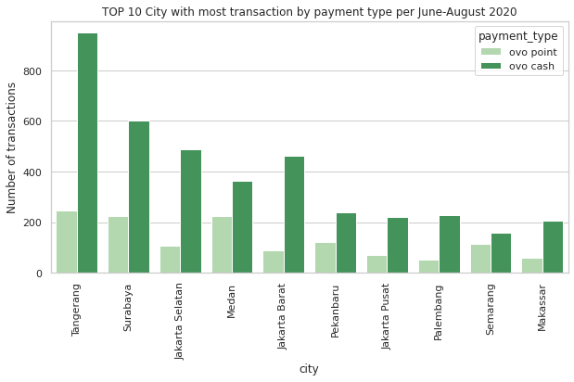
All payment method for all city in TOP 10 is dominating by OVO Cash

Slide 9
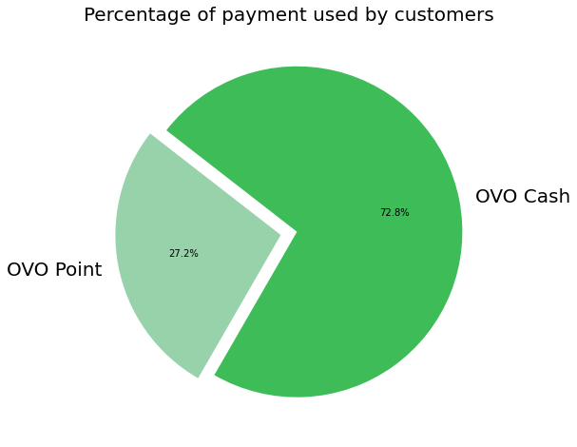
6,700
2,500
Customers using OVO Cash
Customers using OVO Point

Slide 10
~13,014,430 Average
84,828.5 Average
100
Number of transactions happen every day
Total amount every day
Cashback every day

Slide 11
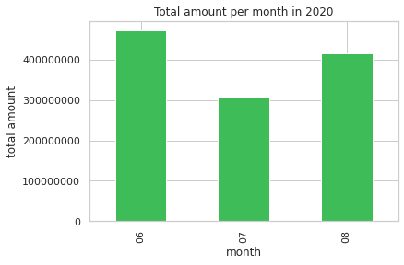
472,349,090
The highest amount is in June 2020

Slide 12
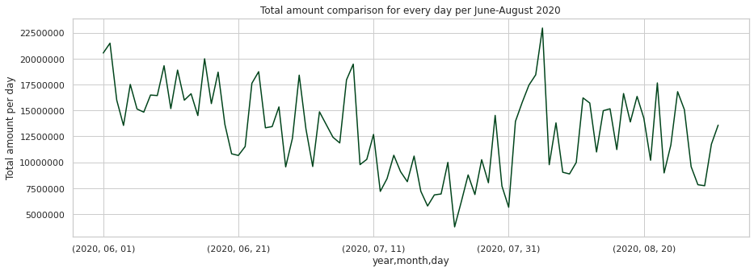

Slide 13
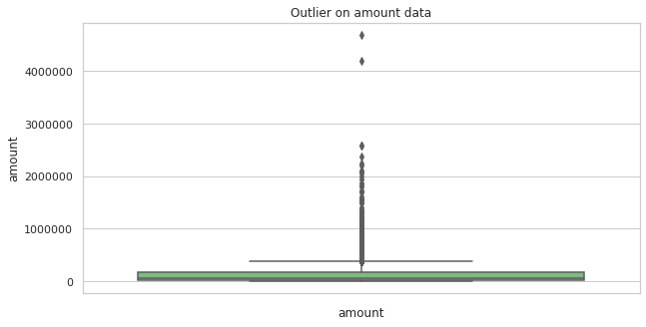
By using box plot, we can see that amount in the data has a quite big outlier there. This is natural since there could be a big nominal in a single transaction from rich customer or from expensive stuff.

Slide 14
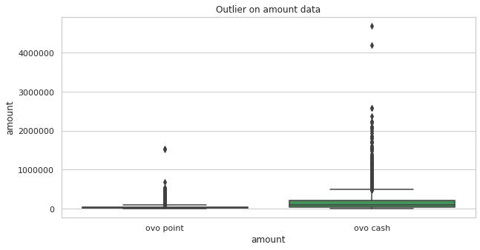
Outlier in ovo point is smaller dan ovo cash. This is happened because the majority of customers are using ovo cash. So there are more variants in the data.

Slide 15
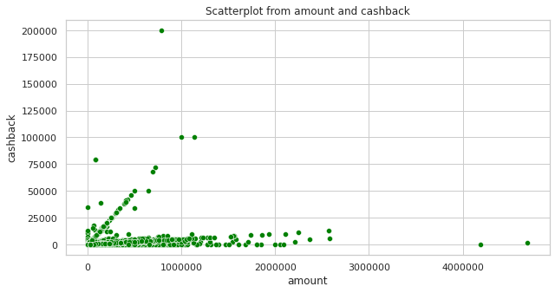
0.5%
45K
Cashback Ratio Avg.
From the scatterplot we see how amount and cashback has a relation with cashback ratio is about 0.5% by average. And there are some data where the cashback has almost 100%. This is possible because OVO could gives high cashback for some customers as a promo.

Slide 16
Rp. 1,220,621,876
Is a total profit in all data by subtracting amount by cashback

Slide 17
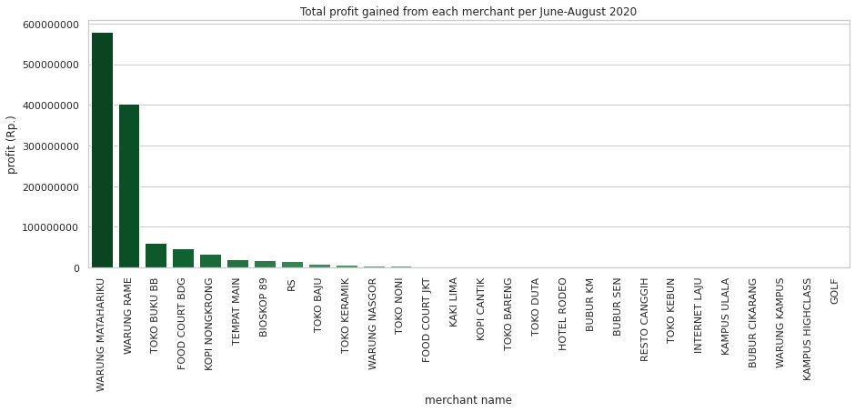
If we see from profit perspective, Warung Matahariku merchant gained more than 550 million rupiah, following by Warung Rame with 400+ million rupiah during June-August 2020. Even Warung Rame has the most transaction happened, Warung Matahariku has more profit than Warung Rame.

Slide 18
Issues to be highlighted

Slide 19
Issue #1
Store Code in ovo transaction data seems inconsistent because it mixed up with long and short code. For example, there is a store code named TCPLJKTLMPU0001 and on the other hand there is code named 490. One is using alphanumeric and one is number only. Would be better if it named with the same format. The data engineer or people who process the data will be more comfortable.

Slide 20
Issue #2
By seeing the big gap between ovo cash and ovo point payment usage. As a senior management, it’s time to discuss and find any ideas how to make the usage of ovo point higher.

Slide 21
1.2
Section

Slide 22
Task 1
List total unique customers that had transactions in JABODETABEK between 4 August 2020 and 17 August 2020.

Slide 23
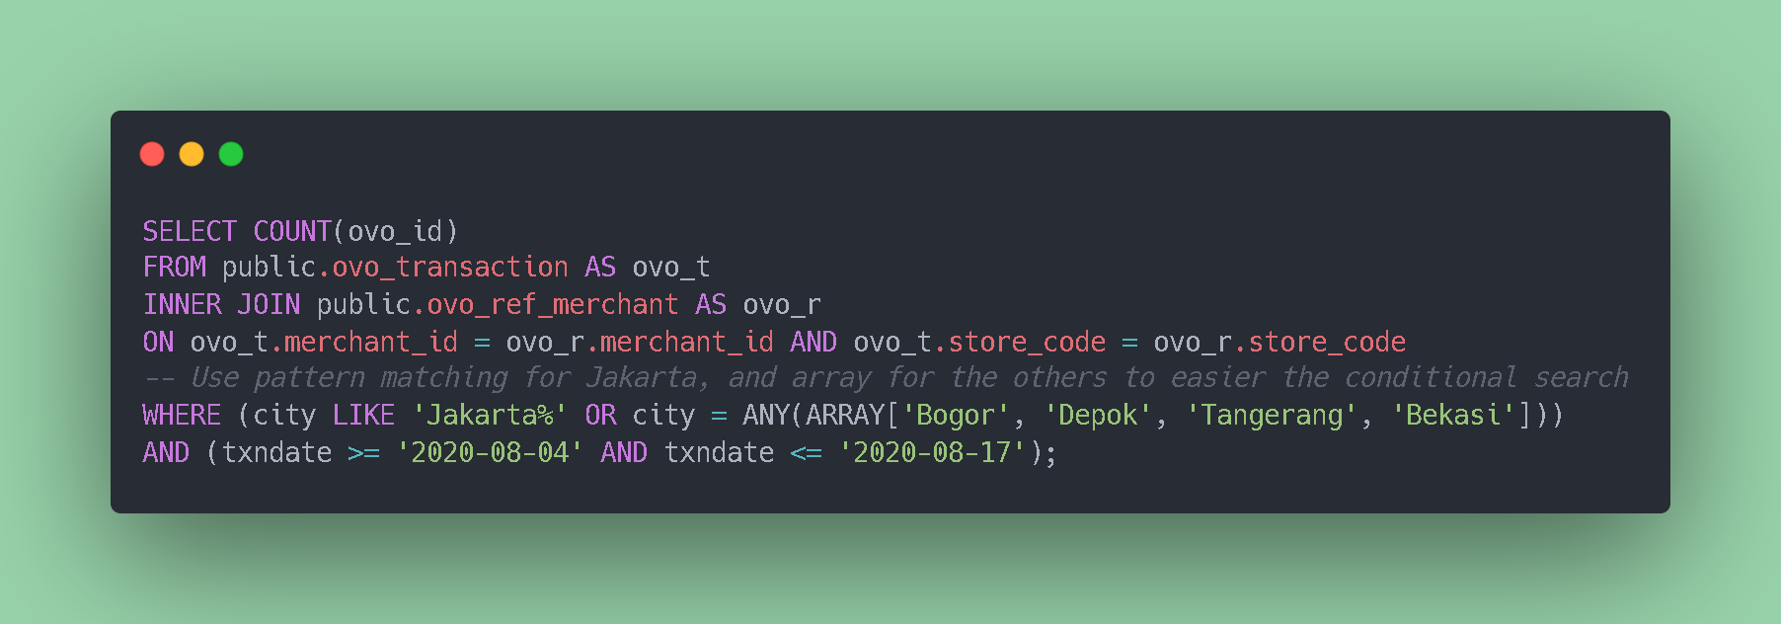
My Solution

Slide 24
Result
total_unique_customer
555
The .csv file for this submission is attached along with this submission

Slide 25
Code for Copy-Paste
The .sql file is available along with this submission, See task1.sql

Slide 26
Task 2
List only the Top 10 cities who had the highest transaction amount, per month.

Slide 27
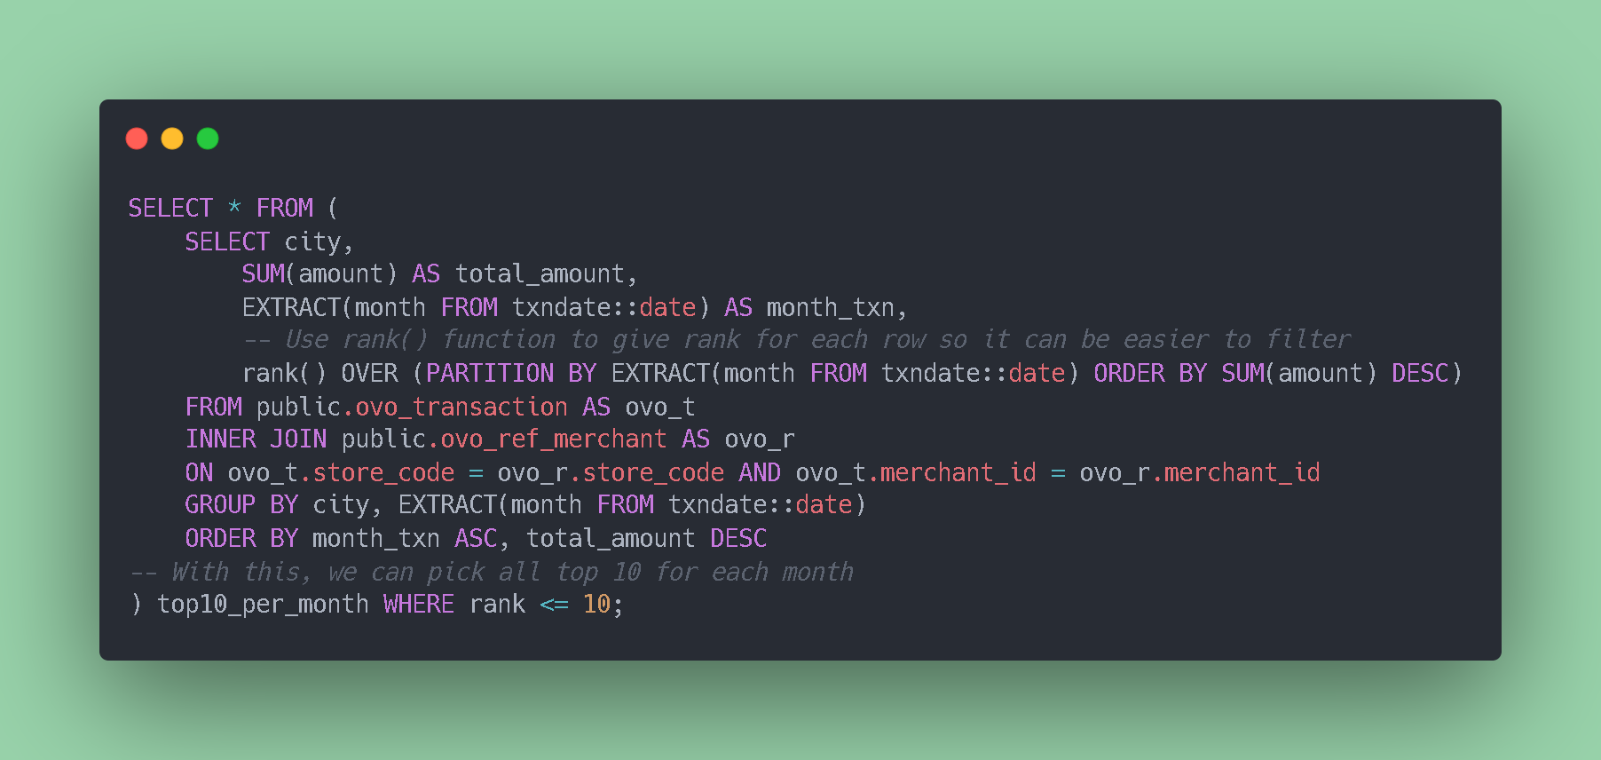
My Solution

Slide 28
Result
city | total_amount | month_txn | rank
Tangerang | 51794450 | 6 | 1
Surabaya | 38026418 | 6 | 2
Jakarta Barat | 32552603 | 6 | 3
Medan | 31708128 | 6 | 4
Pekanbaru | 21507070 | 6 | 5
Jakarta Selatan | 19285370 | 6 | 6
Jakarta Utara | 16143553 | 6 | 7
Makassar | 15902976 | 6 | 8
Palembang | 15395640 | 6 | 9
Jakarta Pusat | 13218880 | 6 | 10
The .csv file for this submission is attached along with this submission

Slide 29
Result (Cont.)
city | total_amount | month_txn | rank
Tangerang | 31940425 | 7 | 1
Surabaya | 30877885 | 7 | 2
Jakarta Barat | 27848050 | 7 | 3
Medan | 23307320 | 7 | 4
Pekanbaru | 15242526 | 7 | 5
Palembang | 12934867 | 7 | 6
Jakarta Utara | 12639128 | 7 | 7
Jakarta Selatan | 10132617 | 7 | 8
Makassar | 9031086 | 7 | 9
Bekasi | 7858880 | 7 | 10
The .csv file for this submission is attached along with this submission

Slide 30
Result (Cont.)
city | total_amount | month_txn | rank
Tangerang | 46943078 | 8 | 1
Surabaya | 35705402 | 8 | 2
Jakarta Barat | 31085902 | 8 | 3
Pekanbaru | 27145565 | 8 | 4
Jakarta Selatan | 24149182 | 8 | 5
Medan | 20500527 | 8 | 6
Palembang | 18565554 | 8 | 7
Jakarta Utara | 14725477 | 8 | 8
Makassar | 11951637 | 8 | 9
Jakarta Pusat | 11625691 | 8 | 10
The .csv file for this submission is attached along with this submission

Slide 31
Code for Copy-Paste
The .sql file is available along with this submission, See task2.sql

Slide 32
Task 3
List total unique customers, total number of transactions, total amount paid, and total cashback per merchant, sort it by total number of transactions from biggest to smallest, then remove merchants who have cash back ratio (total cashback / total amount) below 5%.

Slide 33
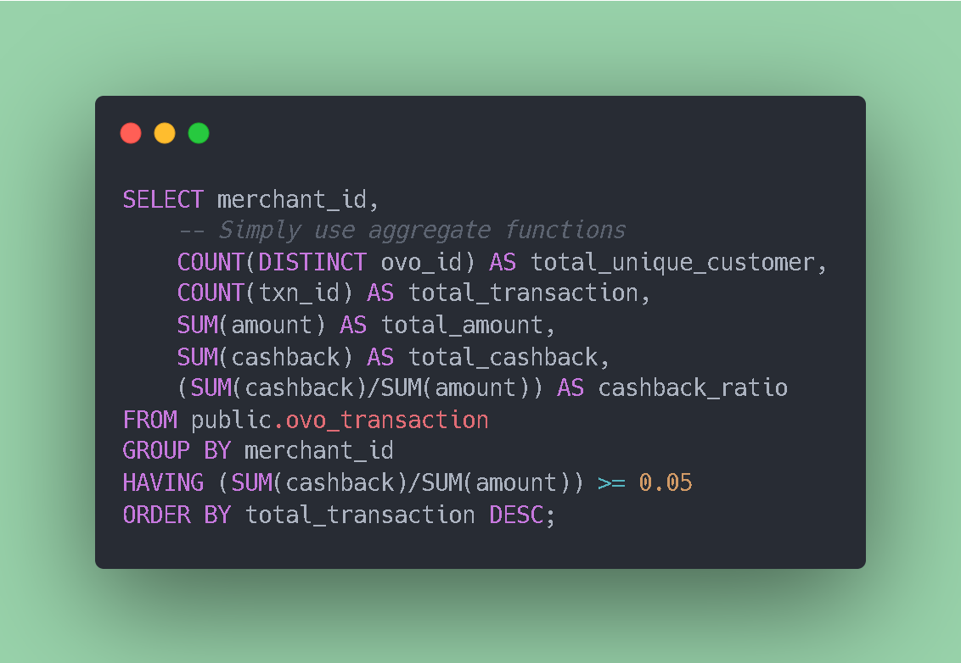
My Solution

Slide 34
Result
merchant_id | total_unique_customer | total_transaction | total_amount | total_cashback | cashback_ratio
275 | 133 | 133 | 22300000 | 1764000 | 0.07910313901345291
2858 | 100 | 102 | 3194000 | 194000 | 0.06073888541014402
17 | 46 | 46 | 5641904 | 470000 | 0.08330521043959628
108 | 10 | 10 | 4288053 | 411000 | 0.09584769591234063
2016 | 4 | 4 | 1356165 | 127000 | 0.09364642207990916
The .csv file for this submission is attached along with this submission

Slide 35
Result (Cont.)
merchant_id | total_unique_customer | total_transaction | total_amount | total_cashback | cashback_ratio
107 | 4 | 4 | 332409 | 31000 | 0.09325860611475621
5110 | 2 | 2 | 110000 | 15000 | 0.13636363636363635
2831 | 1 | 1 | 75000 | 14000 | 0.18666666666666668
155 | 1 | 1 | 426000 | 42000 | 0.09859154929577464
2916 | 1 | 1 | 135000 | 39000 | 0.28888888888888886
5129 | 1 | 1 | 790000 | 200000 | 0.25316455696202533
The .csv file for this submission is attached along with this submission

Slide 36
Code for Copy-Paste
The .sql file is available along with this submission, See task3.sql

Slide 37
Task 4
Show the distribution of customers based on the number of unique merchants s/he had transacted with. (Distribution of customer that have done transaction in 1 unique merchant, 2 unique merchants, 3 unique merchants, etc)

Slide 38
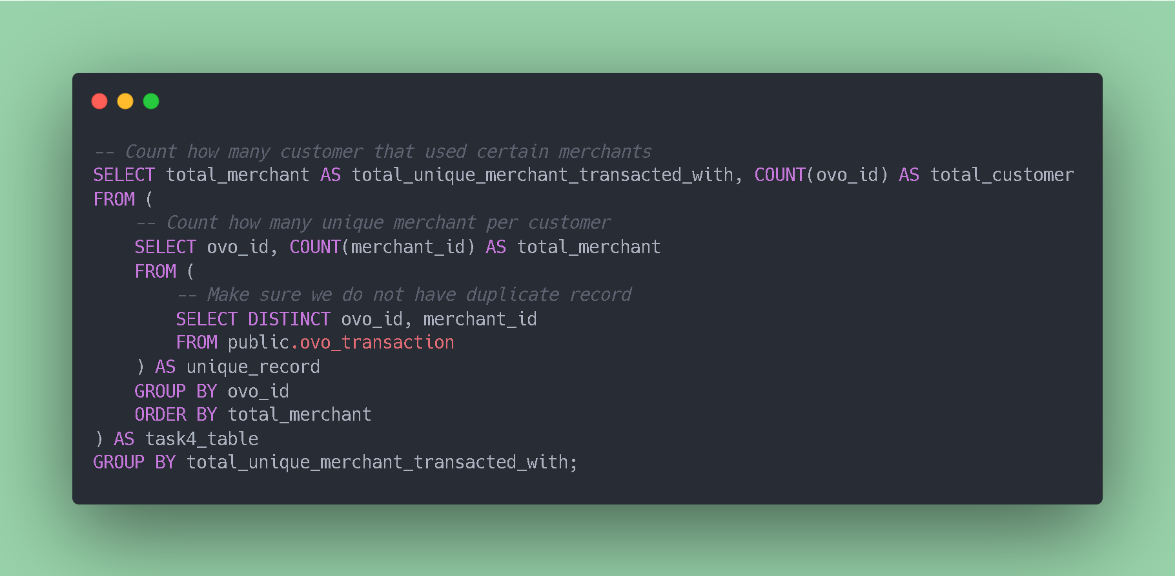
My Solution

Slide 39
Result
total_unique_merchant_transacted_with | total_customer
1 | 9022
2 | 38
3 | 2
From the table above we know that there are 9022 customers that using only one merchant. Following by 38 customers using 2 merchants and 2 customers using 3 different merchants.
The .csv file for this submission is attached along with this submission

Slide 40
Code for Copy-Paste
The .sql file is available along with this submission, See task4.sql

Slide 41
Task 5
List customers who have transactions in the exact following order of merchants: TOKO BAJU, KOPI NONGKRONG, then KAKI LIMA. (If customer have transactions in the same merchant multiple times in sequential order then it counts as one appearance, for example: TOKO BAJU, KOPI NONGKRONG, KOPI NONGKRONG, KAKI LIMA, KOPI NONGKRONG will be TOKO_BAJU, KOPI NONGKRONG, KAKI LIMA, KOPI NONGKRONG)

Slide 42
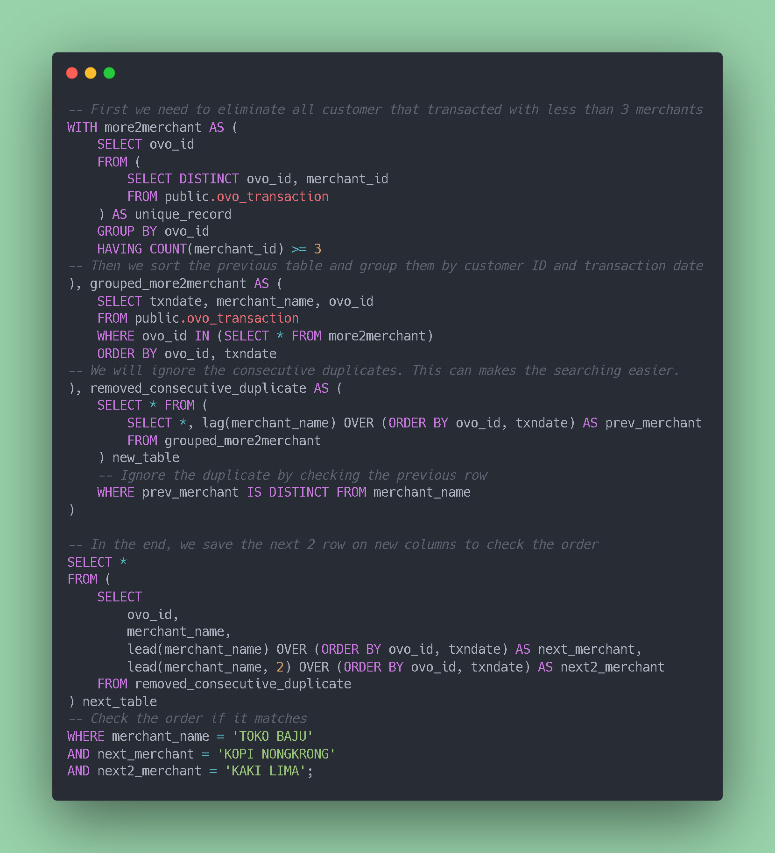
My Solution

Slide 43
My Solution (Cont.)

Slide 44
Result
ovo_id | merchant_name | next_merchant | next2_merchant
0001018008303948 | TOKO BAJU | KOPI NONGKRONG | KAKI LIMA
The .csv file for this submission is attached along with this submission

Slide 45
Code for Copy-Paste
The .sql file is available along with this submission, See task5.sql

Slide 46
Thanks!
That’s all my submission for OVO Business Intelligence Technical Test
Iqrar Agalosi Nureyza
misteriqrar@gmail.com
+62 823 8506 5800

